Slide 1
Class 28: Day B 5/10 & Day A 5/11
Today’s Task: Lesson 8: (8 – W5 MLA Style Report) – [Use Website Class 28 page].
Keyboarding: 3 Minute Typing test when finished with Lesson 7.
Next Task for Today: 8b – Preamble – Word Processing Assessment
Next Task for Today: 9 – Inventory list of Equipement W-11
➔ All Worksheets are at the Back of the Classroom (lab).
4. Falling behind? Check the website, for After School Hours next week.
Lesson 8a: W5 – MLA Report Objective:
Students will follow a series of steps to create and format a mock report for the Jazz My Wheels business. Students will apply prior knowledge of lie spacing formatting, use of footer tools, and adding a MLA Style Citation.
Lesson 8b Preamble Objective: ​Students will activate prior knowledge of skills learned in previous lessons and apply use of the tools and functions of MS Word in this activity.
Standard: 2.J Essentials of Document Processing 2.J.01 Create, edit, format a document for a simulated business.
Business Technology Framework June 2014
5. Done with EVERYTHING ABOVE? My webpage Class 28 see Option A or B
Next Class: Class 29: Lesson 10 – TBD
Business Letter and W20: Newsletter (MS Word Assessment)

Slide 2
Class 27: Day A 5/11 & Day B 5/10
Today’s Task: Lesson 7: Business Memo (7 – W3 Business Memo)
Keyboarding: 3 Minute Typing test when finished with Lesson 7.
Next Task for Today: Lesson 8: (8 – W5 MLA Style Report)
➔ All Worksheets are at the Back of the Classroom (lab).
4. Check the website, Class 27 for After School Hours next week, if you are falling behind.
Lesson 7: W3 – Business Memo Objective:
Students will follow a series of steps to create and format a Business Memo, using font effects Superscipt, double spacing formatting, and adding a MLA Style Citation, as guided, a for a simulated business titled “Squeaky Clean”.
Lesson 8: W5 – MLA Report Objective:
Students will follow a series of steps to create and format a mock report for the Jazz My Wheels business. Students will apply prior knowledge of lie spacing formatting, use of footer tools, and adding a MLA Style Citation.
4. Done with EVERYTHING ABOVE? My webpage Class 27 see Option A or B
Next Class: Class 28: Lesson 8B - Preamble
Lesson 9 / W20 – Newsletter (MS Word Assessment)

Slide 3
Class 21 - Today’s Assignment 4.11.18 & 4.12.18
3 Formatting Font and More: The Bicycle Paragraph
Today’s Overall Objectives:
New Objectives:
Students will be introduced to:
Inserting Comments
Altering Line Spacing from Single to Double using the Line Spacing Tool
Inserting a Header & Footer
Paragraph Alignment Tools/Shortcuts (center, left/right align & justify)
Bulleted & Numbered List
Continuing Objectives:
Students will navigate the teacher’s webpage to access class lessons and activities.
Students will practice downloading files & saving to a network drive (H:/ drive – Class Folder.)
Students will be continue lessons using skills to access and apply Font Editing Tools of Word.

Slide 4
Class 21 - Formatting Font? (3) Bicycle Paragraph Activity:
Students will continue learning about the features of MS Word 2017 and how to use the Font and Formatting Tools. In one to two class sessions, students should be able to create a document with columns an edit a word processed document. In addition, name and save the file to a designated folder.
Specific Objectives:
•Inserting Comments
•Altering Line Spacing from Single to Double using the Line Spacing Tool
•Inserting a Header & Footer
•Paragraph Alignment Tools/Shortcuts (center, left/right align & justify)
•Bulleted & Numbered List
Step1: Go to my Webpage, to access the Word Project, click on Lesson 3 Formatting Font? Bicycle Paragraph
Step2: Download the instructions & save to your COMP APPS?WORD Folder.
Step3: Read all instructions & understand you are working on page 2 of the Instruction Sheet in MS WORD.
Step 4: You may use the paper copy to guide you step by step. Ask for help as needed!
Step5: Follow ALL instructions carefully, asking for assistance as needed!
Step6: Again make sure you save the file to your COMP APPS/MS WORD Class folder.

Slide 5
Class 18: Homophones & Spell Checker Project/Activity: Spell Checker Poem
Exercise 2: Synonym Finder: Part 2 - A Follow Up Lesson

Slide 6
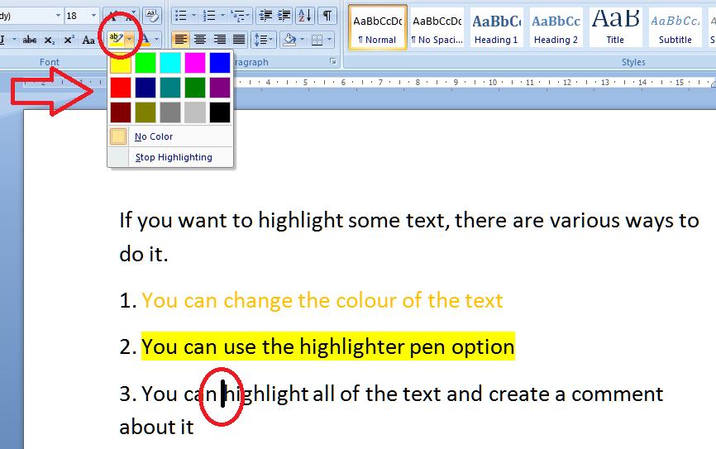
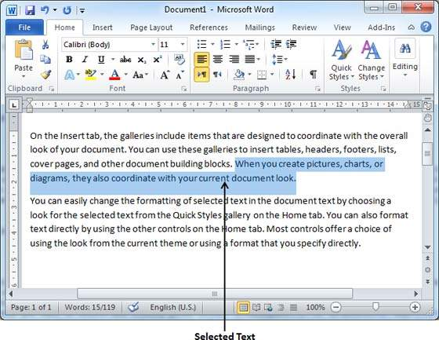
Class 16: Select text vs Highlight (Tool/Pen)
Students will review 5 links about Selecting text and the Highlight Tool (pen).
Students will do so to become familiar with the difference.
Student gain clarity of the term Select Text (Highlight) to be successful in lessons of Comp Apps.

Slide 7
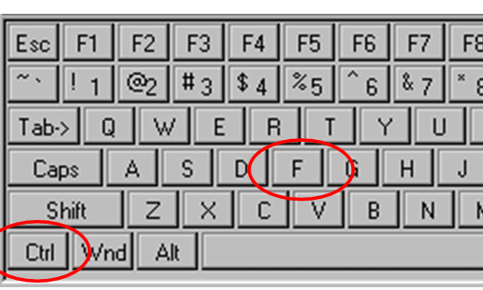
Class 17 - Shortcut Trick: FIND Feature Find feature, Bookmarking & Synonym Finder Tools
Using the Find Feature [CTRL + F] in Word & Chrome
CTRL + F
Helps locate a word within a document or web page.
In MS Word is gives you’re the Navigation Pane.
In chrome or a PDF it offer a search box.

Slide 8
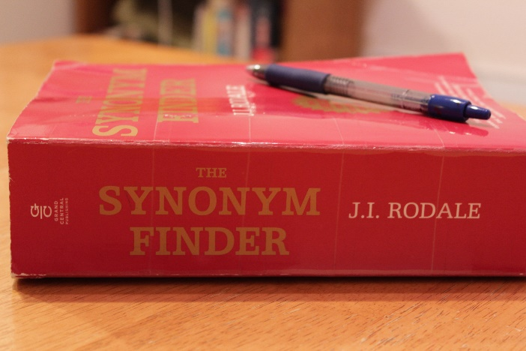
Review: How do you activate the Synonym Finder?
Class 17: Synonym Finder &
More Proofing Tools Part 2
Objective 1: Students will view a quick 1 minute video on use of the Synonym Finder Tool & Thesaurus.
Objective 2: Students will complete and activity using Proofing Tools to locate and replace Synonyms.

Slide 9
Review: How do you activate the Synonym Finder?
Class 17: Synonym Finder &
More Proofing Tools Part 2
Task: Students will complete and activity using Proofing Tools to locate and replace Synonyms.

Slide 10
Class 19: Homophones & Spell Checker Project/Activity: Spell Checker Poem
Exercise 2: Synonym Finder: Part 2 - A Follow Up Lesson
Students will follow the steps on the worksheet Part 1 and Part 2. Part 1 is similar to the previous activity- it is a reinforcement activity. Part 2 is a skill builder activity where students will demonstrate their understanding of the concept of using synonym finder. Students will also reinforce their knowledge of saving to the H:/ Drive in the class folder as per instructions.

Slide 11
Class 19: Create a Poster Using MS WORD Project/Activity: Class President Flyer
Students will follow a series of steps via a worksheet to complete a Class President Flyer/Poster Using MS Word.
2.J Essentials of Document Processing
2.J.01 Create, edit, format and print a document.
Performance Example(s): Students will be assigned a business name, and each student will create informational material, such as brochures, business cards, flyers, etc., for said business.
Specific Objectives:
• Practice Character Formatting • Understand Font, Font Style & Font Effect • Use short cut keys for Bold and Italics • Applying a Page Border • Copy & Paste election themed image using wrap options.
Students will receive a brief introduction to Word 2017s Font and Formatting Tools (see image). In one to two class sessions, students should be able to create a simple document (flyer) and manipulate its appearance and text. In addition, name and save the file to a designated folder.

Slide 12
Class 19:
Class President Flyer: Using the Font Edit Tools of MS Word
Students will follow a series of steps via a worksheet to complete a Class President Flyer/Poster Using MS Word.
Specific Objectives:
• Practice Character Formatting • Understand Font, Font Style & Font Effect • Use short cut keys for Bold and Italics • Applying a Page Border • Copy & Paste election themed image using wrap options.
Let’s Begin:
In this lesson you will download 2 files and save them to your H:/ Drive (Comp Apps Folder – MS Word Folder)
Step1: Go to MY WEBSITE and will access the Lesson1 Fun with Fonts Activity as guided by the teacher
Step2: On the Lesson1 Fun with Fonts Page there are two files you will download and save for this lesson.
Step3: Click on Lesson 1 Fun with Fonts to access the Class President Lesson document titled: lesson_1_class_president_flyer_starter_document_msword.docx
Step4: Download this file to your H:/ Drive Comp Apps/MS WORD Folder (Not One Drive). Ask for help if needed.
Step5: Do not rename this file. Leave the file name as it is named.
Step6: Download the PDF File – the direction sheet for the lesson and save this file to the H:/ Drive Comp Apps/MS WORD Folder
Step7: Read & Review the directions. All the steps & complete the lesson. Use the direction sheet like a checklist! ✓
Ask for help as needed. I am measuring your ability to work independently. Ask for help to make sure you understand.

Slide 13
Class 17 - Shortcut Trick: Find feature, Bookmarking & Synonym Finder Tools
Using [CTRL + D] to book mark a Webpage quickly.
CTRL+ D Adds a Favorite / Bookmark more quickly.
This is helpful when doing research.

Slide 14
Reminder:

Slide 15
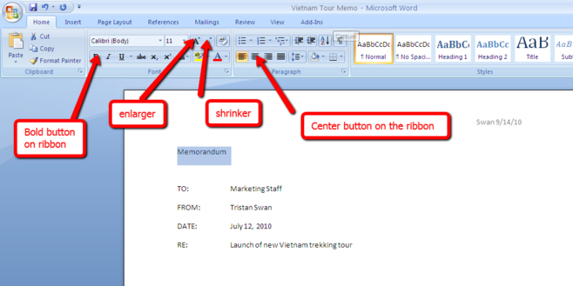
Class 15: MS Word – Basic Training
Students will watch SIX short videos to become more familiar of Use of Microsoft Word and its tools, functions and features.
Students will gather ONE FACT per video and record them on the worksheet.
Students will save the worksheet to their Word Folder in their Comp Apps Folder on the H:/ Drive (networked drive).
Students will follow steps A - D on the webpage to complete this assignment.
Videos 1 – 3 : Write and Edit Using MS Word
Videos 4 -6: Formatting Text in MS Word

Slide 16
Class 13/14: Introduction to MS Word
Students will watch THREE videos to become more familiar of Microsoft Word and its use in the classroom and workplace as well as via a mobile device. Students will gather THREE FACTS for the videos and record them on the worksheet and save it to the Word Folder in their Comp Apps Folder. Student should follow steps 1-3 on the teacher’s web page for Class 13, to complete this assignment.
Video 1 What is Word?
Video 2 Using Word on a Mobile Device
Video 3 Creating a Document

Slide 17
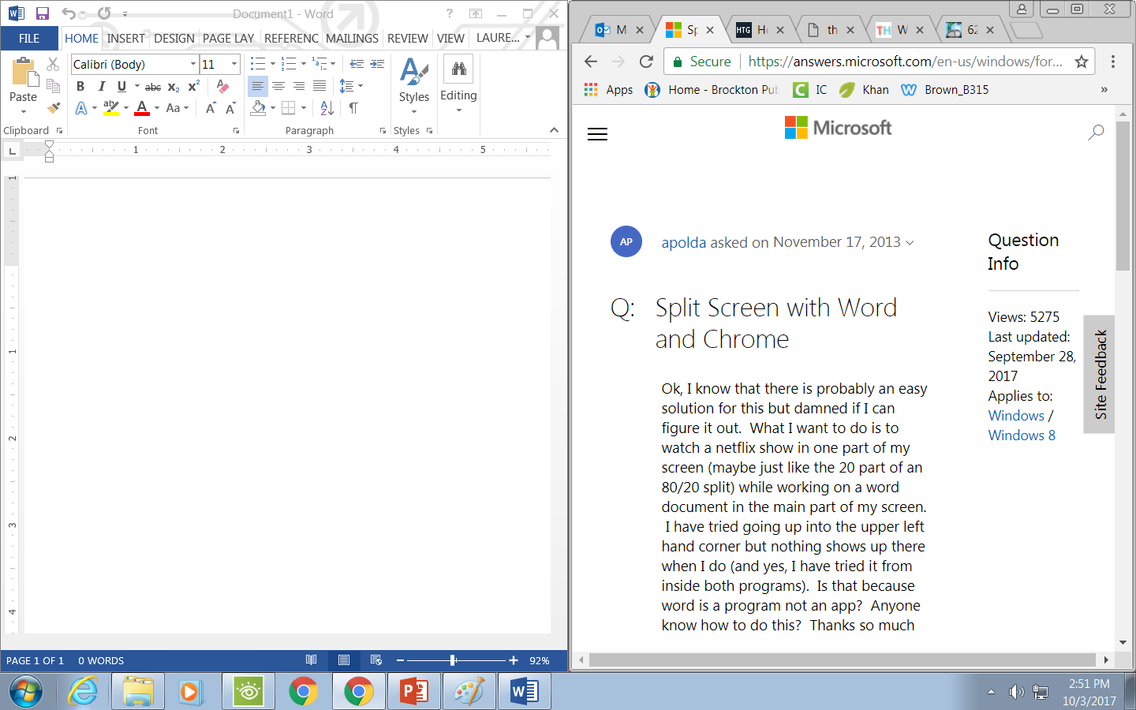
Class 13/14 – A review…
Split Screen View: What are the advantages?
Word Processor
Webpage for Research

Slide 18
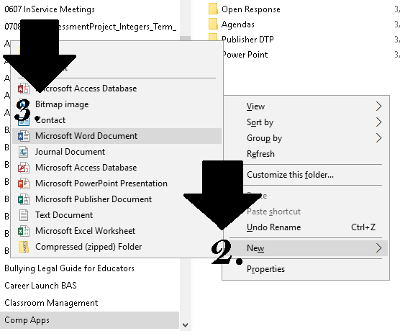
How? 1. Open your CompApps Folder 2. Right Click in a white open are inside the folder. 3. In the drop down menu select (2.) New (see image) 4. In the cascading menu, select (3.) Microsoft Word 5. A New Microsoft Word Document should appear. 6. Re-Name this File as TEST. 7. Don’t know how to perform a RENAME function? ASK!! 8. Done? Wait Quietly for the next part of this lesson.
Class 12: Creating Test File for Drag & Drop
Part 1:
Open your H:/ Drive CompApps Folder In this folder you will create a MS Word File named Test by following the next few steps.
Phones are away, out of YOUR REACH and MY SIGHT! Not Charging!

Slide 19
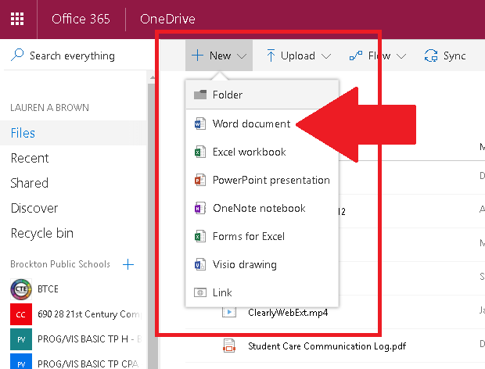
How? 1. Log in to School Email. 2. Click the APP Icon for One Drive 3. Click the NEW Button (See A) 4. Then click Word Document (See B) 5. Rename this file TEST. 6. Click NEW again (See A) 7. Click Folder & Folder name is CompApps. 8. When done wait for instructions from the teacher.
Class 12: Drag & Drop Test File to One Drive
PART 2:
Log into School (BPS) Email
Access One Drive, by locating and clicking the One Drive Icon. In this folder you will create a COMP APPS Folder as per direction of your Teacher.
A
B

Slide 20
Use Chrome not Explorer in this Lab!

Slide 21
Class 6&7:
Office 365 Login:
Apps & Download Capability
File Management
Create & Name a Class Folder on a Student Profile/Network (H:/ Drive)
Found on next slide…(slide 4)
Drag & Drop options to move files. (Slide 14)

Slide 22
Class Six & Seven: File Management & Accessing the Network Drive
Click Start Button
Click Documents
Look to the LEFT SIDE PANEL
Locate your ID number on the H:/ Drive
Double Click to Open the Drive to access your storage space on the District’s Network.
NOTE:
This is NOT ONE DRIVE our Office 365 Cloud Storage.

Slide 23
File Arrangement: Part 2
Add one more folder name AGENDA!

Slide 24
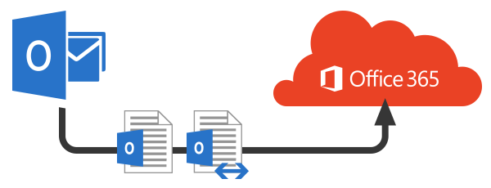
Class Six & Seven: Understanding saving & document storage.
We will view the explainer video created by Ms. Gallant of your Foreign Language Department.
This video will offer us a simple explanation of file storage through the years, from floppy disks to the cloud.
This will help us as we become more familiar navigating Office 365™
https://youtu.be/IYoRlqCnGdc

Slide 25
Class 6: Care & Treatment of Equipment
Reminder:
Defacing school property/vandalism:
Graffiti/destruction of property
is how it is offense appears in the handbook.
In this lab removing the foot stands of keyboards, tampering with equipment and cords, writing on equipment and furniture will not be tolerated and will result in an office referral.
Personal Space:
Never touch any person or their equipment as it is considered “Hands-On Behavior”.
Never reach over and tamper with or touch anyone's keyboard or computer without their consent.

Slide 26
REMINDER:
Phones away when instructed.
Ear buds are NOT displayed, put them away, please.
Listen to & follow this directive.
Phones are NOT Charging or visible.

Slide 27
Last Class:
District Email Accounts & Forwarding Email (Class 4)
Class 5:
Keyboarding - Warm Up & 1 Typing Test (1 min.)
Do Lessons for 10 minutes.
Care and Handling of classroom technology
Infinite Campus Portal Access
Attendance
Buy Backs
Auto Failure
This Photo by Unknown Author is licensed under CC BY-SA

Slide 28
Class Five: Accessing the Student Portal
Infinite Campus Student Portal:
https://sis.bpsma.org/campus/portal/brockton.jsp OR
Ms. Brown’s Webpage and click Student Portal Menu Tab
Username: Type your student ID number Password: Your full birthday [mm/dd/yyyy]
Review:
Buy Backs
Attendance
Auto Failure

Slide 29
So far in this class we have…
Reviewed Fire Drill Protocol from B315
Reviewed the Class Motto - “Keep It Professional!”
Accessed District Email and reviewed Themes (in Settings) and Forwarding to Personal Email.
Reviewed Rules & Expectations
Coordinated Seating
Been successful with Network Logon using Student ID & DOB
Reviewed the Guiding Question & typed up final draft in MS Forms (Pre-Assessment)
Had a Keyboarding Overview (Goal is 5wpm X your grade level.)
Learned about the process for Assessment of Typing.com focusing on Activity of ALL TIME.
Accessed the teacher’s webpage.
Created Favorites & Desktop Shortcuts for www.BrownB315.weebly.com & Typing.com
Infinite Campus and Policy (Buy Back, Attendance & Auto Fail)

Slide 30
Class Four: Our Class Motto is… Let’s Keep it Professional
Think about what that means to you…
Will be discussed, at length, later on…
17 Tips on Ms. Brown’s Webpage

Slide 31
Exit Procedures
Log Off
Switch User/Other User (Optional)
Area is Neat
Any trash should be thrown away
Chairs pushed in BEFORE you leave, wait by your seat
Gather all personal belongings
Dismissed by the teacher, NOT the BELL

Slide 32
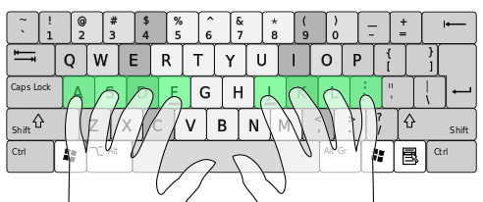
Class Two: Keyboarding Introduction & Assessment Page Review
Accessing TYPING.COM
Creating an Account for Class use.
Digital Literacy Frameworks:
Typing Speed Expectations Grade 9 - 45wpm & 95% Accuracy Grade 10 - 50wpm & 95% Accuracy Grade 11 - 55wpm & 95% Accuracy
By the end of the semester students should type: ⇨

Slide 33
Quick Write Assignment Line 1: Your first and last name Line 2: Day & Period of this class Line 3: Today’s Date. [Skip 2 lines…] Line 6: Write the title - ​Guiding Question: Line 7: Re-write the question as it appears here: Line 7: Guiding Question: How will being proficient using computer applications/technology make me: Line 8: (a) a better student Line 9: (b) more valuable/marketable/employable in the workplace? Line 11: Students will follow the directions below to complete the Quick Write Pre-Assessment Directions: To demonstrate understanding of this guiding question you will answer the above questions in paragraph form. Proper grammar, punctuation & to the best of your ability – correct spelling. There should be four examples in total to support your answer. Two examples for (a) and two examples for (b).

